Slide 1

Department of Computer Engineering
Academic Year 2025-2026 (Odd Sem)
SMA IA
Hindi–English Parallel Text Analytics
Shrikant Chiddarwar (A–07)
Rohit Chauhan (A–06)
Supervisor
Prof. Pradnya Patil

Slide 2

Introduction
Hindi–English Parallel Text Analytics focuses on analyzing bilingual sentence pairs using NLP techniques
It uses large datasets where each English sentence is paired with its Hindi translation
Helps in understanding how machines translate between two different languages
Plays an important role in building multilingual AI systems

Slide 3
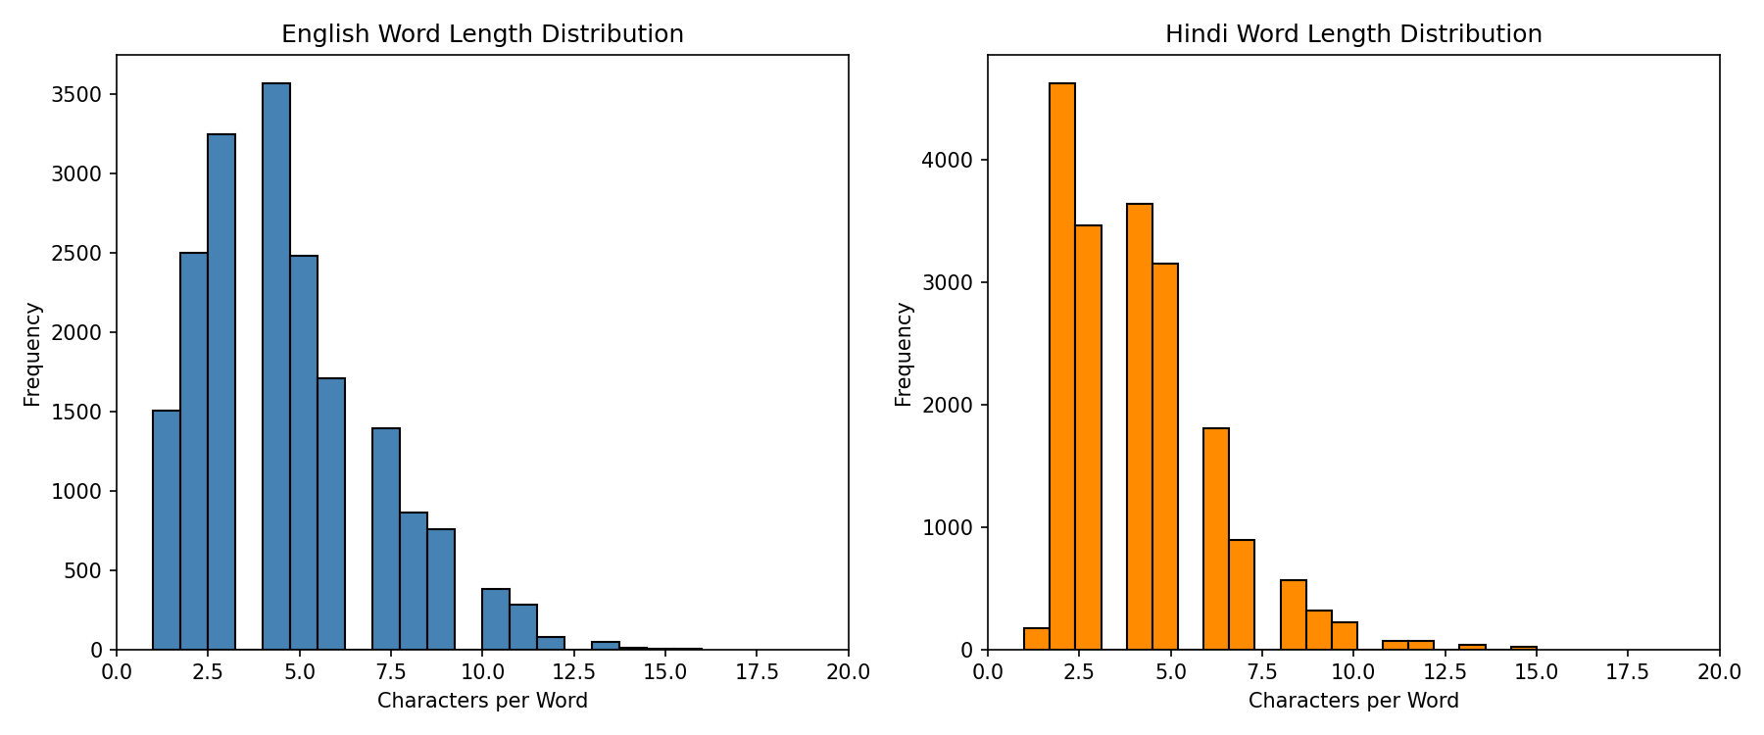
Objectives
Evaluate how accurate machine translation systems are
Identify key challenges in English → Hindi translation
Compare structure, vocabulary, and grammar of both languages
Suggest better evaluation methods for translation

Slide 4
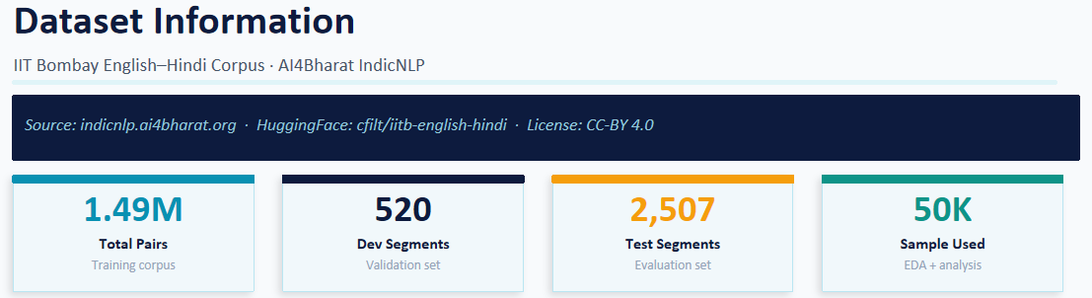
Dataset
The dataset used is the IIT Bombay English–Hindi Parallel Corpus
It contains aligned sentence pairs where each English sentence has a corresponding Hindi translation
Total dataset size:
~1.49 million training sentence pairs
520 validation (development) pairs
2,507 test sentence pairs
The dataset is widely used for:
Machine Translation research
Cross-lingual NLP tasks
A subset of 50,000 sentence pairs was selected for Exploratory Data Analysis (EDA)
The test dataset (2,507 pairs) was used for evaluating translation performance

Slide 5
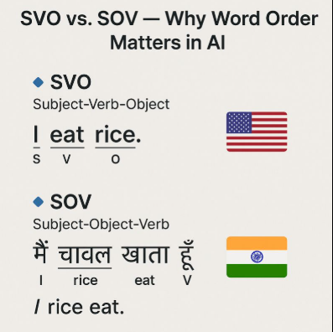
Key Challenges
Word Order Difference
English: Subject–Verb–Object (SVO)
Hindi: Subject–Object–Verb (SOV)
Script Difference
English: Latin (A–Z)
Hindi: Devanagari (अ, क, ख…)
Morphology Complexity
One English word → many Hindi forms
Example: go → जाता, गई, जाएंगे

Slide 6
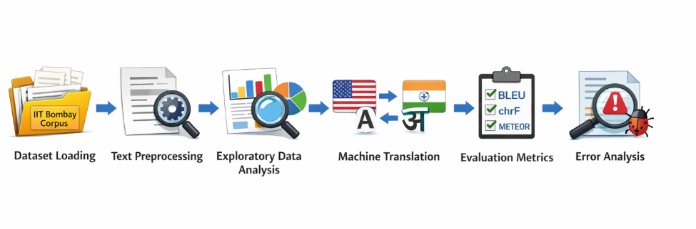
Methodology (Pipeline)
Dataset Loading (IIT Bombay Corpus)
Text Preprocessing (cleaning & normalization)
Exploratory Data Analysis (EDA)
Machine Translation using Helsinki-NLP
Evaluation using BLEU, chrF, METEOR
Error Analysis & Comparison

Slide 7
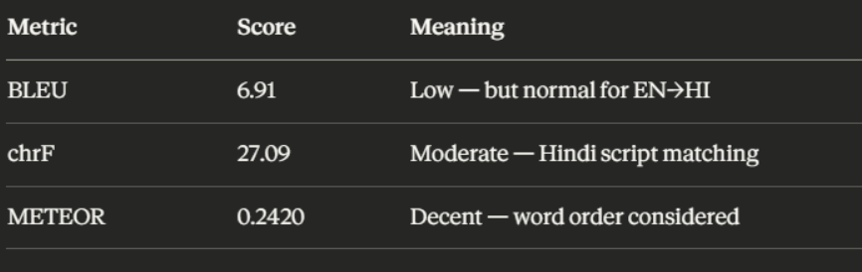
Evaluation Metrics and Results
BLEU Score
Measures exact word matches
Not very effective for Hindi
chrF Score
Measures character-level similarity
Better for morphologically rich languages
METEOR Score
Considers meaning and synonyms
Gives better semantic understanding
BLEU Score: 6.91 (Low)
chrF Score: 27.09 (Moderate)
METEOR Score: 0.242 (Decent)

Slide 8
Conclusion
This project demonstrates that Hindi–English machine translation is a complex task due to major differences in grammar, word order (SVO vs SOV), script, and morphology
The translation model (Helsinki-NLP) is able to generate meaningful but not fully accurate translations, especially struggling with long and complex sentences
Evaluation results show that:
BLEU score is very low because it depends on exact word matching
chrF and METEOR provide more realistic evaluation, especially for morphologically rich languages like Hindi
The study highlights that morphology and sentence structure are the biggest challenges affecting translation quality
Error analysis proves that:
Short and simple sentences are translated well
Long, domain-specific, and complex sentences lead to higher errors
Overall, the project emphasizes that both better models and better evaluation metrics are required for improving Hindi–English translation systems

